Slide 1
Trying to figure out why some brands do very well in their smart watches devices and the things that affect their brands.
Let’s see!

Slide 2
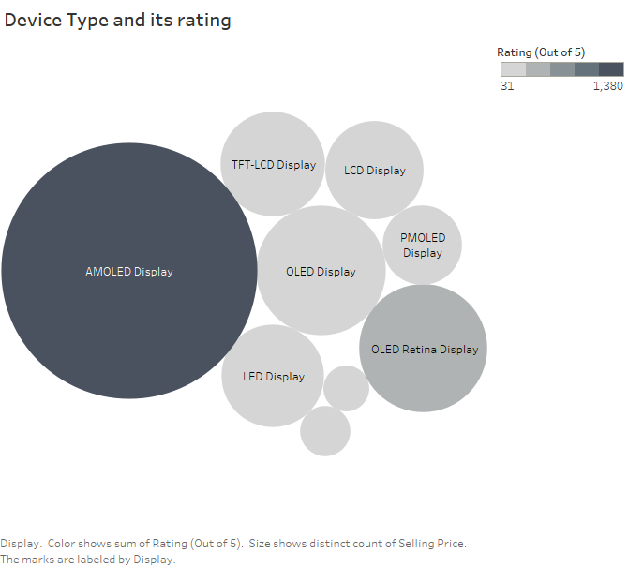
On this following picture you may notice that certain device types seems to have the greater ratings.
So for example AMOLED DISPLAY is conquering more than 40% of the ratings collected in year 2018

Slide 3
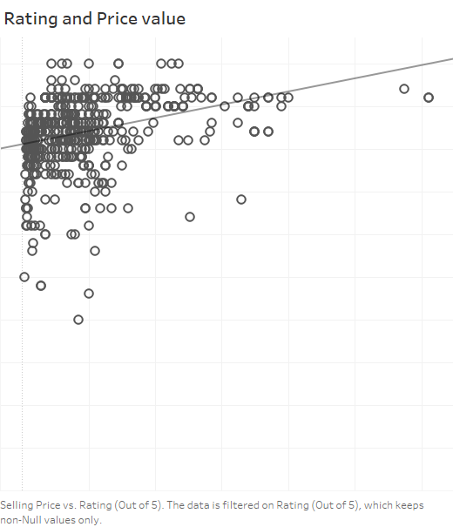
Now here on this vizualisation a positive co-relation came up between price values and the rating .
My analytical reason for this is that more expensive products especially in this industry seems to be equivalent to good quality and value.

Slide 4
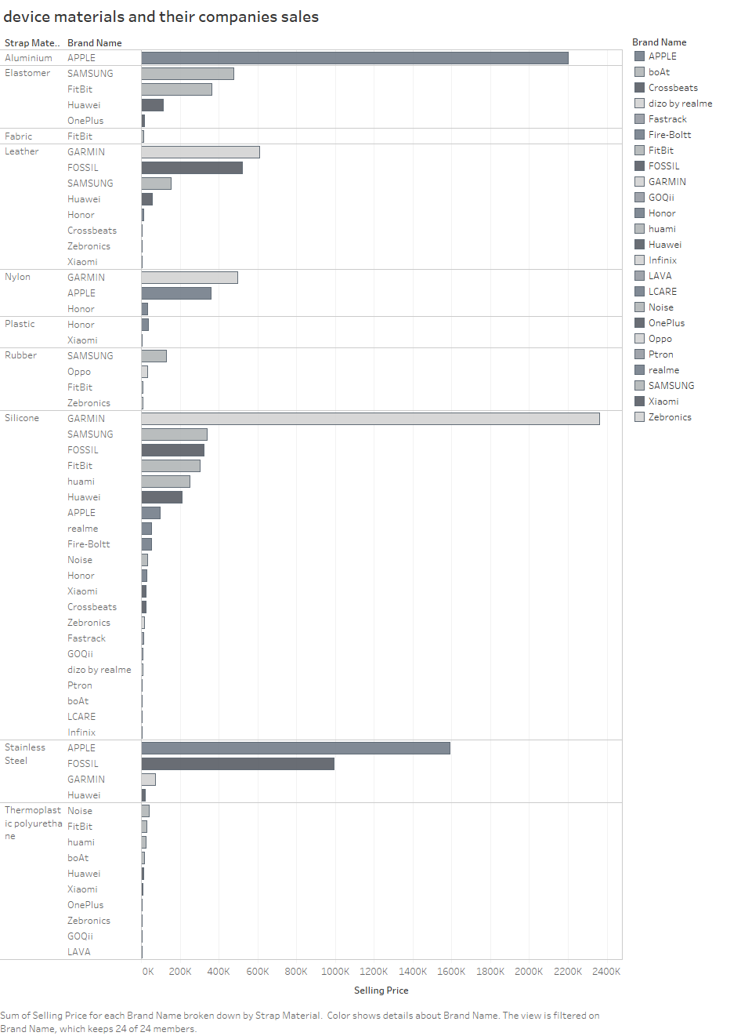
regarding our last conclusion of high prices = high quality , let me give you this vizualisation.
Apple which is the most selling company regarding smart watches seems to have been using Aluminum in their products manufacturing.
By doing some extra research on my own , Aluminum in comparison to all of the other materials seems to be the cheapest on the list. You may ask why?
I’ll give you the answer in the final slide

Slide 5
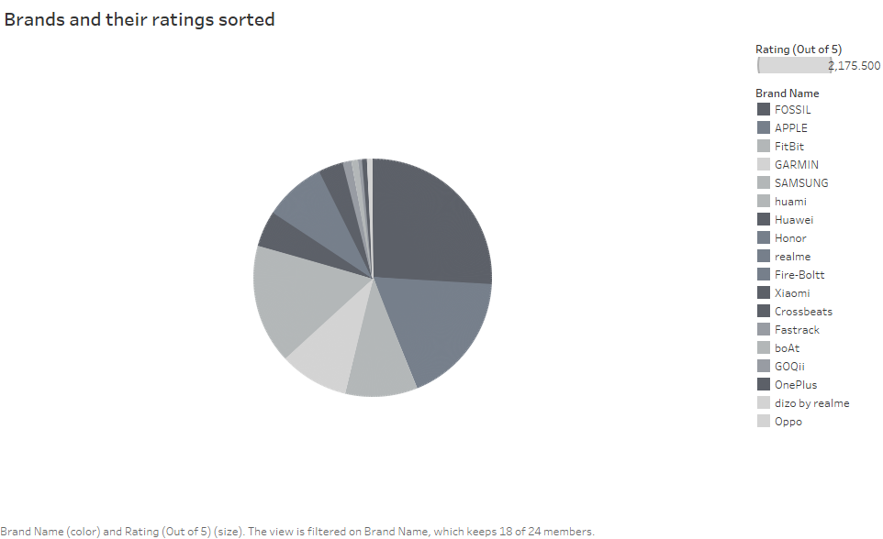
On this image, on opposite to the sales image.
Inspite of apple making the best sales, Fossil seems to have slightly higher ratings.
Well that explains your confusion on the previous slide. As much as Apple made way more sales than Fossils, Fossils have slightly more ratings that’s why I want mention that difference between them is slightly different , Which I will explain in the last slide as well

Slide 6
Here is our observations and on the next slide I will explain these points.
Apple and Fossils made sales both of them got ratings but Apple almost won in both sides
Prices where co-related with high quality which was shown in the image but when looking at Apple pricing compared to Fossils it’s much higher now let me explain what is the theory behind that

Slide 7
Conclusions
For me it seemed unrealistic that apple uses Aluminum in most of their watches which is very basic and not premium like those fossils use and they have the ability to sell it with higher prices but here’s the reason:
Apple’s branding is crucial and the way the market their products make it seem like a high end product which in some cases end up being horrible
Due to this marketing and branding strategies you may fall into the trap of value = your money
And also with some research as much as aluminum is weak, a lot of reports said that the reason Apple’s watch is so popular and sell a lot is that watches are not always meant to be premium as much as they should be comfortable, branded and durable which is exactly what apple does.
The reason Fossils made the greatest ratings is because their premium materials and features , you know as much as they’re not branded very well the few people that buy it all experience the same feeling High-end.
Using AMOLED type really does increase the probability of you getting more positive reviews such as Apple and Fossil use AMOLED display in more than 80% of their watches

Slide 8
This is a self made project so after all of these conclusions let me tell somethings to do when choosing your smart watch.
Apple is a great option especially for its features and durability but in the same time understand that using a weak material in your watch may affect its timeline with you.
Although watches should be comfortable as I just said, it’s an investment so make sure you choose your material carefully use my visualization if you want.
Do not always associate a high price for a very premium quality sometimes its just good branding and when it comes to reality it’s not always worth the money , Take fossils and apple for example, Fossils got better reviews overall
If you wonder “ then why did apple gain so many reviews as well ?” , then my points in this slide answers this
Reports says that the estimation time for someone reviewing a product is probably 1-3 days
*you can’t even know its flaws*

Slide 9
thank you for standing by for that long I appreciate it!
If you get to see this presentation, feel free to contact me and tell me your opinion about this confusing topic at:
miriamashraf@gmail.com

